Slide 1


Comparelo
VIT Bhopal University
Bhopal-Indore Highway, Kothri Kalan, Sehore, Madhya Pradesh – 466114.
~ Your one-stop platform
DSN4098 Project Exhibition
Under the Guidance of:
Dr Sukumar
Team Members
Sneha Vasudev (22BEY10060)
Palak Jain (22BEY10075)
Prerna Kumari (22BEY10020)
Prince Sahu (22BEY10117)
Divyanshu Pratap Singh (22BEY10018)
Vinit Kumar (22BEY10069)

Slide 2


What is Comparelo ?
In today's hectic environment, we think It might be a tedious and prolonged process to compare several things online for hours. But what if you could compare more than two things in a single website?
Comparelo is a platform that would completely change the way we compare items. With so many alternatives available to us, it's critical that we have a tool that can assist us in making informed selections quickly and efficiently. This presentation will explore how an intuitive website interface can maximize consumer decision-making potential by efficiently comparing products.

Slide 3

Objective/Problem statement
Problem: Consumers are faced with an overwhelming number of options when making purchasing decisions. Whether it is a price or quality comparison, people switch between multiple sites to get the best deal.
The main objective of our project is to allow users to compare multiple products side-by-side in a single website, we solve the problem of information overload and make it easy to make informed purchasing decisions.
With our website users can quickly and easily compare products based on their specific needs and preferences. This is not only convenient for consumers, but also for businesses that need to compare multiple products for procurement purposes.

Slide 4
Literature review
Websites that compare products have grown to be an important component of the e-commerce industry, helping customers to make wise purchases. This review examines how these platforms function, their advantages, and their difficulties as mentioned in pertinent academic literature.
Consumer Empowerment: Research suggests that product comparison websites empower consumers by providing them with a wealth of product information, allowing them to compare features, specifications, and user reviews, thus increasing their confidence in decision-making (Hossain et al., 2015; Feinberg et al., 2014).
Price Transparency: One of the primary benefits of product comparison websites is their ability to provide consumers with real-time pricing information from various retailers. Such platforms enable users to identify the best deals and discounts available (Ghose and Yang, 2009).
Time-Saving: The convenience of having product data aggregated in one place saves consumers time that would otherwise be spent navigating multiple retail websites (Moe and Trusov, 2011).
Trust and Credibility: Reviews and ratings contributed by users on these platforms enhance trust and credibility. Shoppers often rely on peer reviews to validate their purchase decisions (Dellarocas et al., 2007).
Data Accuracy: Data accuracy and completeness are key concerns. Product information is often scraped from various sources, leading to potential discrepancies in descriptions, availability, or pricing (Kamishima et al., 2013).
Review Manipulation: Some users and retailers engage in review manipulation, posting fake reviews or biased feedback that can mislead consumers (Jindal and Liu, 2007).

Slide 5
Existing work with limitation
Google Shopping:
Limitation: Google Shopping primarily relies on data provided by retailers and advertisers. This can lead to discrepancies in pricing and product availability, as well as limited coverage of smaller or niche retailers.
ShopSavvy:
Limitation: ShopSavvy primarily caters to mobile users. While this is beneficial for on-the-go shopping, it may not offer the same level of detail and functionality as web-based comparison websites.
Shopzilla:
Limitation: Shopzilla focuses on product listings and price comparisons but may lack advanced features such as personalized recommendations and real-time inventory status.
PriceGrabber:
Limitation: While PriceGrabber offers price comparison, its user reviews and ratings may not always be comprehensive or up-to-date, impacting the reliability of user-generated content.

Slide 6
Proposed Work
Real-Time Data Updates:
Goal: Provide users with up-to-the-minute information.
Approach: Implement real-time data scraping and updates to ensure that product prices and availability are continuously accurate.
Enhanced User Experience: User experience will be a focal point, with a user-friendly interface, intuitive navigation, and responsive design to ensure seamless usage on both desktop and mobile devices.

Slide 7
Hardware and Software requirements
HARDWARE
Web hosting server
Database server
User interface designing tool
SOFTWARE
Frontend technology (HTML,CSS, JavaScript)
Backend technology (Python)
Search engine
Web Scrapping
Tools API Integration

Slide 8





Detailed Model Algorithm

Slide 9
Step 1: Define Requirements
1. Determining the scope of our website (e.g., product categories, features, user interface).
2. Identifying the technologies and tools needed (e.g., web development framework, database, Amazon API).
Step 2: Set Up the Development Environment
1. Choose a web development framework (e.g. Express.js).
2. Set up a version control system (e.g., Git) to track changes.
3. Create a database to store product information.
Step 3: Amazon Product Data Retrieval
1. Register for an Amazon Associates account to access the Product Advertising API.
2. Obtain API keys and configure API access.
3. Implement code to fetch product data from Amazon using the API (e.g., product name, price, description, URL).
4. Store retrieved product data in our database.
Step 4: User Registration and Authentication (Optional)
1. Implement user registration and login functionality (if desired).
2. Secure user data and passwords.
Step 5: Building the Website
1. Designing the user interface for our website (e.g., product search, comparison, user profiles).
2. Implementing a search feature that allows users to search for products.
3. Display search results, including product details and prices.
4. Implement a comparison feature that allows users to select and compare products.
5. Implement sorting and filtering options to help users find the best results.
6. Create user-friendly URLs for product pages.

Slide 10
Step 6: Price Comparison Logic
1. Develop an algorithm to compare prices and determine the best result.
2. Factors to consider may include price, shipping costs, ratings, and seller reputation.
3. Present the best result prominently to the user.
Step 7: User Interaction and Feedback
1. Allow users to leave reviews and ratings for products.
2. Implement a feedback system to improve user experience.
3. Handle user queries and issues.
Step 8: Performance Optimization
1. Optimize database queries for fast product retrieval.
2. Implement caching mechanisms to reduce API requests to Amazon.
3. Ensure the website is responsive and loads quickly.
Step 9: Security
1. Implement security measures to protect user data and prevent common web vulnerabilities (e.g., SQL injection, cross-site scripting).
2. Use secure connections (HTTPS) to protect user data in transit.
Step 10: Testing and Quality Assurance
1. Conduct thorough testing, including unit tests, integration tests, and user acceptance testing.
2. Fix any bugs and issues identified during testing.
3. Ensure cross-browser compatibility and responsive design.
Step 11: Deployment
1. Choose a hosting provider and deploy your website.
2. Configure domain settings
3. Monitor website performance and server health.

Slide 11




Work Flow

Slide 12
-- Start --
-- User Interaction --
[User Visits Website] --> [Enters Product Details]
-- Data Gathering --
[Query Product Information] --> [Retrieve Data from Retailers] --> [Store Data]
-- Data Processing --
[Filter and Normalize Data] --> [Sort by Price] --> [Generate Comparison Results]
-- User Interface --
[Display Comparison Results]
-- User Interaction --

Slide 13
[User Selects a Product]
-- More Data Gathering --
[Retrieve Detailed Product Information]
-- Display Product Details --
[Show Product Name, Description, Reviews, Ratings, etc.]
-- User Interaction --
[User Selects a Retailer or Option to Purchase]
-- Redirect to Retailer --
[User Redirected to Retailer's Website for Purchase]
-- End --

Slide 14
Implementation and Coding

Slide 15
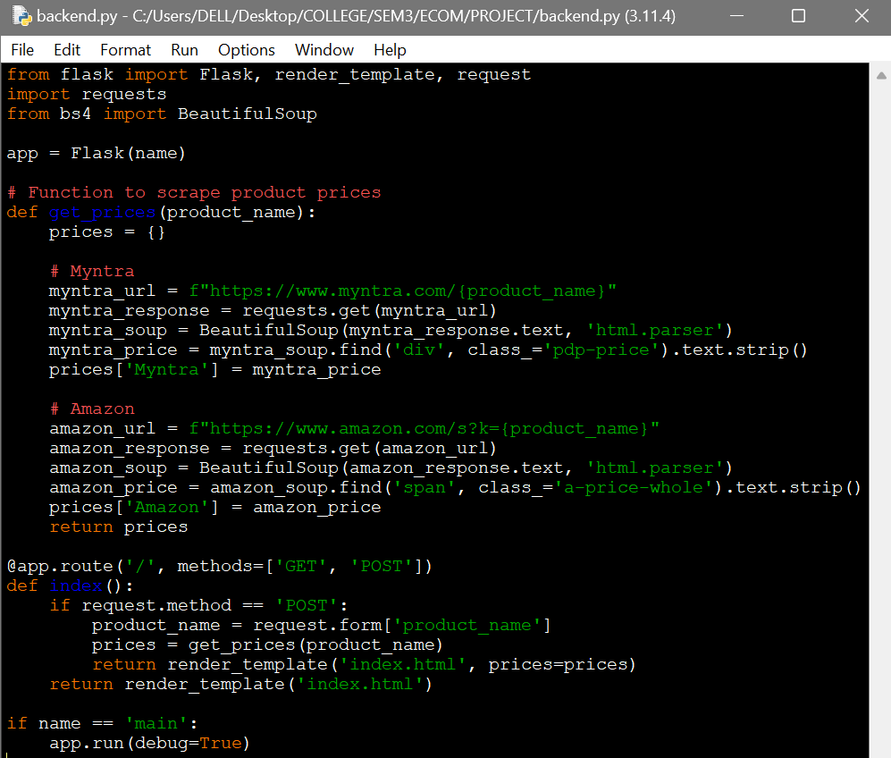
Back-End snippets

Slide 16
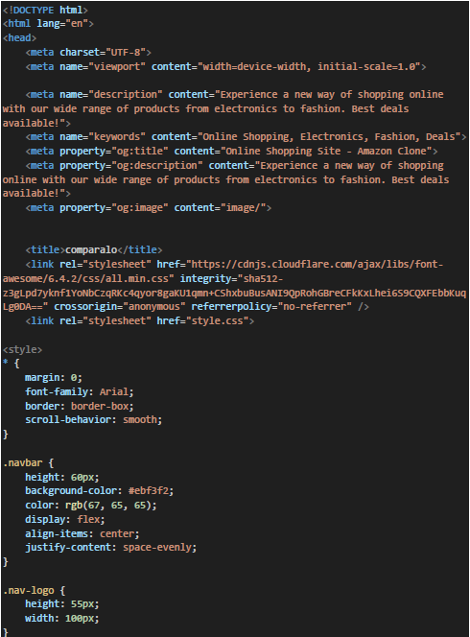
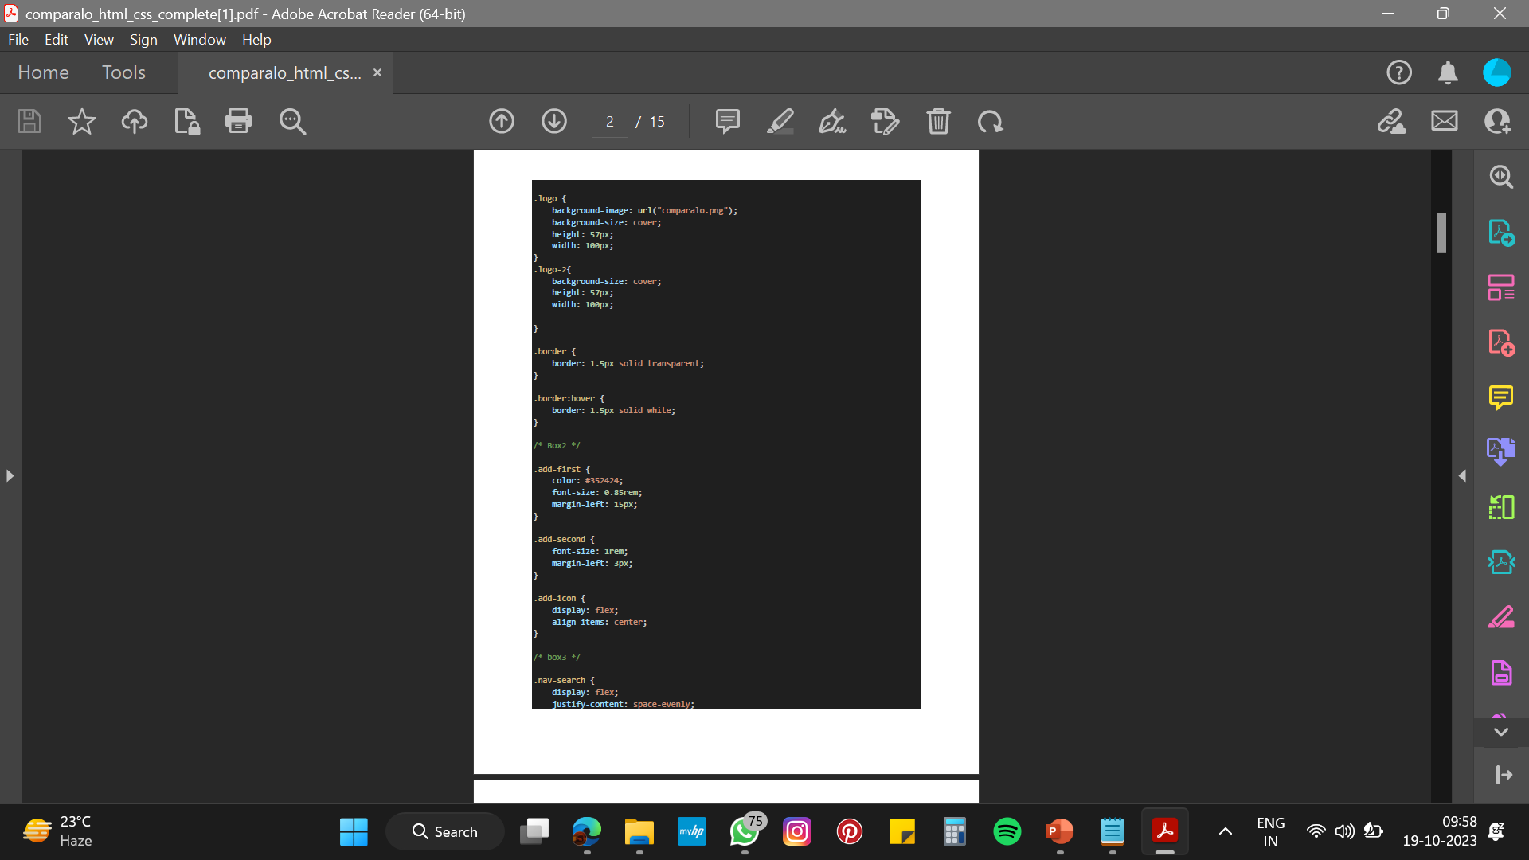
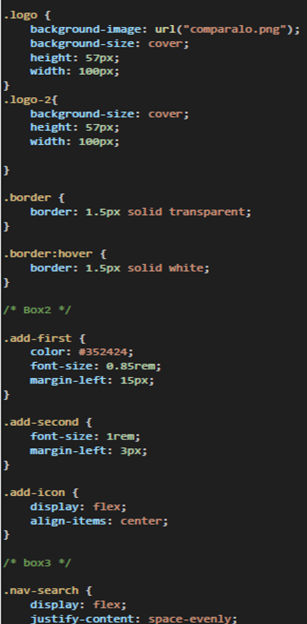


Slide 17
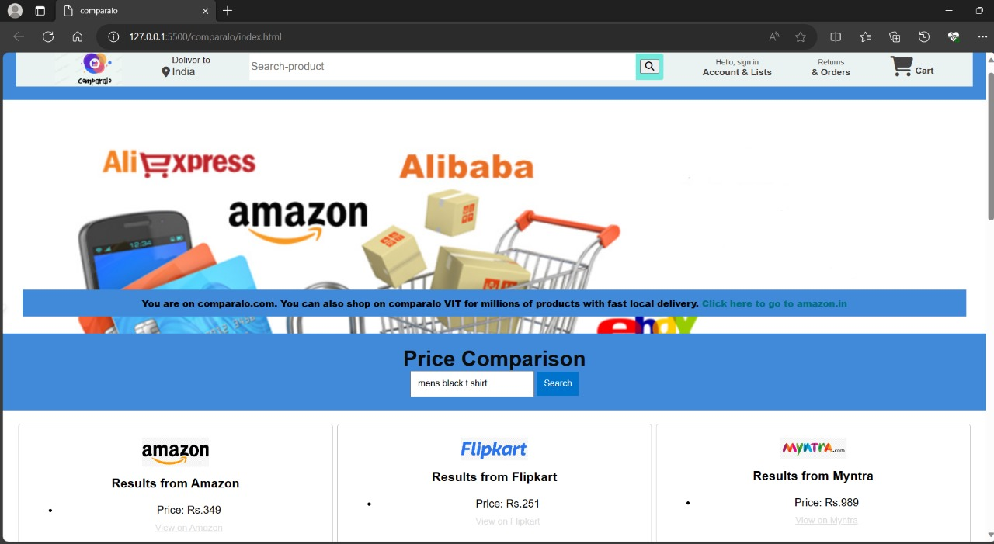
Working Model

Slide 18
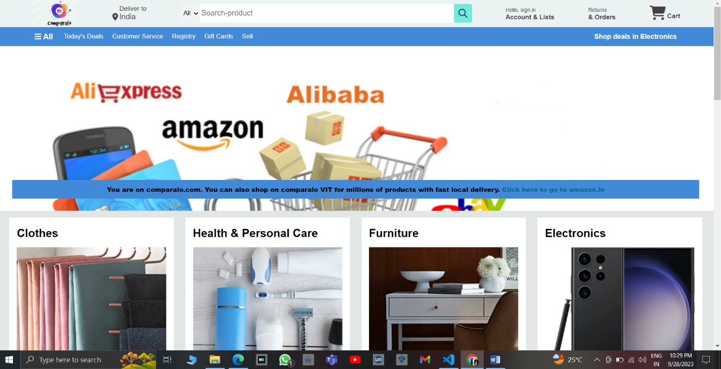

Slide 19
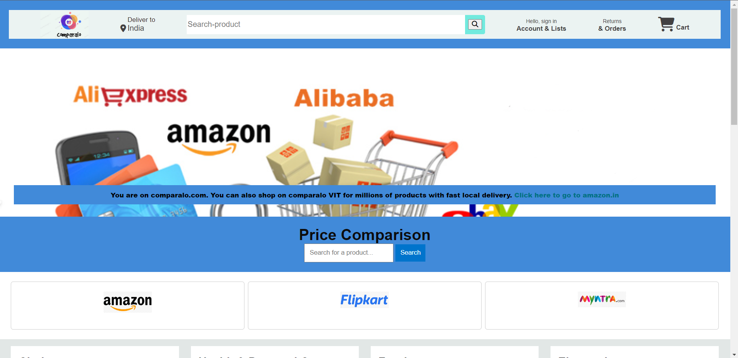

Slide 20
CONCLUSION

Slide 21
Comparelo is a revolutionary platform that addresses the challenge of information overload when comparing products online. It allows users to conveniently compare multiple products side-by-side in one app, simplifying purchasing decisions for consumers and procurement processes for businesses.
Comparelo's primary goal is to provide real-time data updates to ensure accurate pricing and availability information. Additionally, it focuses on enhancing the user experience with a user-friendly interface, intuitive navigation, and responsive design for both desktop and mobile devices. Comparelo aims to transform the way consumers and businesses make informed product selections efficiently.
CONCLUSION

Slide 22
References
https://www.researchgate.net/publication/348923873_PRICE_COMPARISON_WEBSITEs
https://medium.com/gobeyond-ai/how-to-create-a-great-product-comparison-page-to-boost-conversions-a37bf95681fd
Hossain, M. M., Rahman, M. S., & Nahar, S. (2015). Customer satisfaction and switching barriers: Effects on customer loyalty. International Journal of Information Management, 35(1), 71-82.
Dellarocas, C., Zhang, X., & Awad, N. F. (2007). Exploring the value of online product reviews in forecasting sales: The case of motion pictures. Journal of Interactive Marketing, 21(4), 23-45.
Kamishima, T., Kazawa, H., & Akaho, S. (2013). Improving the accuracy and comprehensibility of item recommendation. User Modeling and User-Adapted Interaction, 23(5), 407-440.
Jindal, N., & Liu, B. (2007). Review spam detection. In Proceedings of the 16th international conference on World Wide Web (WWW'07) (pp. 1189-1190).
https://youtu.be/9dY4ExUEgZw?si=j7R26VPtHqh3_aHm
https://youtu.be/M_bhZEY6_kM?si=eitH5OPGGlYRtjpn
https://amzn.eu/d/8kWaHsJ
https://www.flipkart.com/

